Slide 2
MEMBER TYPES
CUSTOMER
DISTRIBUTOR
(Can Earn Commissions)

Slide 3
IMPACT REWARDS PLAN
01 Earn
commissions & bonuses
01 No Membership or Renewal Fee
DISTRIBUTOR BENEFITS
02 Receive
Wholesale
pricing
02 Receive
Wholesale
pricing
CUSTOMER BENEFITS
03 Earn
free products
points
03 Earn
Free product
points
04 Earn prizes,
Awards, &
incentive
trips
05 Participate
In Distributor-
exclusive
promos

Slide 4
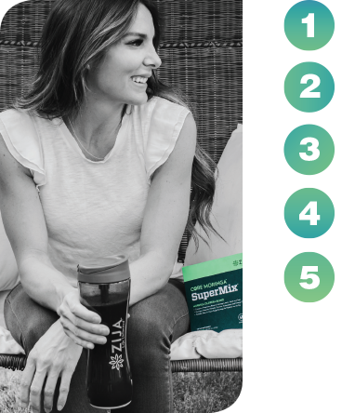
5 WAYS TO EARN
Fast Start Commissions (FSC)
Get Qualified Bonus (GQ Bonus)
Team Commissions
Customer Retention Bonuses
Leadership Bonuses

Slide 5
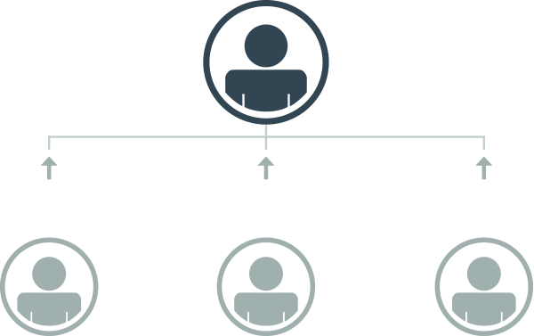
FAST START COMMISSIONS
ACTIVE 75 YOU EARN
ACTIVE 150 YOU EARN
YOU
(FSC)
(FSC)
25% = $37.50
15% = $22.50
25% = $62.50
15% = $37.50
25% = $125
15% = $75
150 PV
250 PV
500 PV
Initial Order from Newly Enrolled Customer
Initial Order from Newly Enrolled Customer
Initial Order from Newly Enrolled Distributor

Slide 6
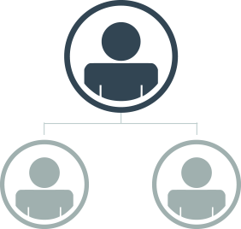
GET QUALIFIED BONUS
OR
YOU
YOU
ENROLL 1
ENROLL 2
ENROLL 1
ENROLL 2
150 PV Initial Order & 75+ PV Zija Rewards Purchase
150 PV Initial Order & 75+ PV Zija Rewards Purchase
250 PV Initial Order & 75+ PV Zija Rewards Purchase
250 PV Initial Order & 75+ PV Zija Rewards Purchase
*Up to $500 per Cycle

Slide 7
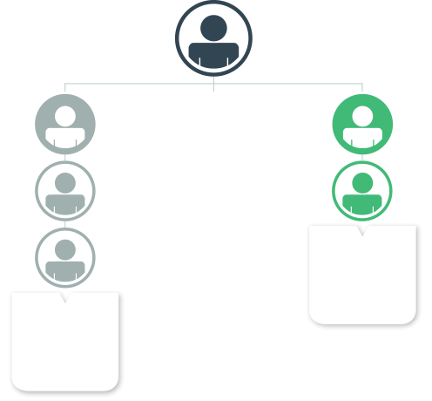
TEAM COMMISSIONS
YOU EARN
YOU
In Team Commissions
LEFT LEG
RIGHT LEG
150 PV
PE
250 PV
PE
250 PV
250 PV
TOTAL
500
COMMISSIONABLE
VOLUME
200 PV
TOTAL
600
COMMISSIONABLE
VOLUME

Slide 8
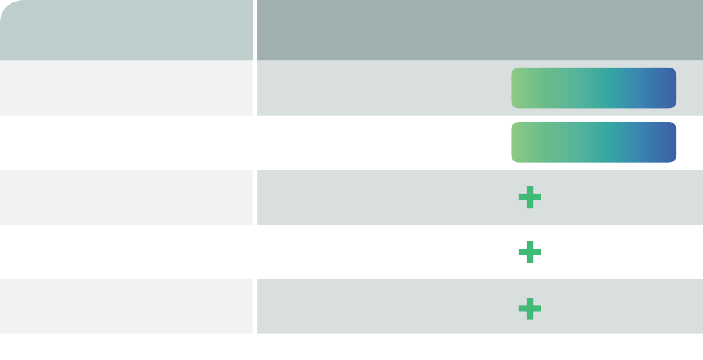
CUSTOMER RETENTION BONUSES
CUSTOMER VOLUME LEVEL
REWARD
500 - 999
$100/75 PV ZIJA REWARDS PURCHASE
CLUB 500
$200/150 PV ZIJA REWARDS PURCHASE
CLUB 1000
1,000 – 2,499
$200/150 PV ZIJA REWARDS PURCHASE
$250 CASH BONUS
2,500 – 4,999
$200/150 PV ZIJA REWARDS PURCHASE
$500 CASH BONUS
5,000 – 9,999
$200/150 PV ZIJA REWARDS PURCHASE
$1,000 CASH BONUS
10,000

Slide 9
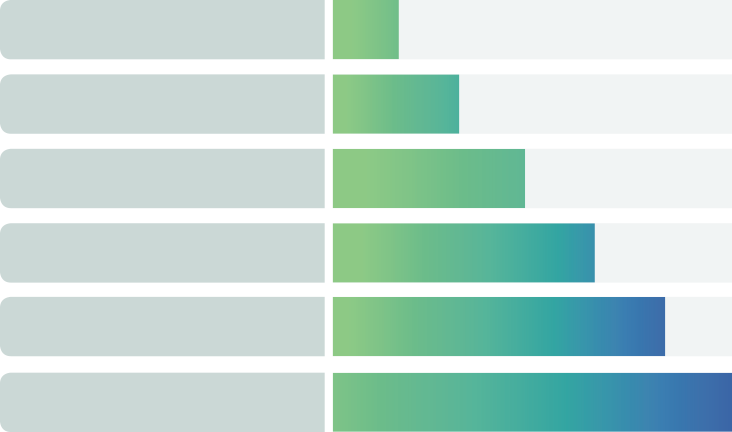
LEADERSHIP BONUSES
LIFESTYLE BONUS
$75 PER CYCLE $300 PER PERIOD
GOLD TO PLATINUM
$100 PER CYCLE $400 PER PERIOD
EMERALD
$125 PER CYCLE $500 PER PERIOD
DIAMOND
$150 PER CYCLE $600 PER PERIOD
BLACK DIAMOND
$175 PER CYCLE $700 PER PERIOD
DIAMOND ELITE
$200 PER CYCLE $800 PER PERIOD
IMPERIAL DIAMOND+

Slide 10
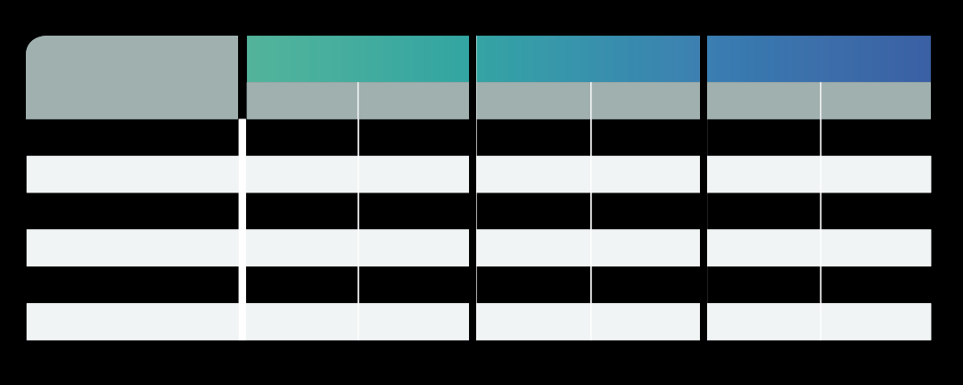
LEADERSHIP POOLS
EMERALD POOL
DIAMOND POOL
DIAMOND ELITE POOL
RANK
Generations
Qualifier
Generations
Qualifier
Generations
Qualifier
Emerald
4
Bronze and
Above
—
—
—
—
Diamond
5
Bronze and
Above
Infinitely
Bronze and
Above
—
—
Black Diamond
6
Bronze and
Above
Infinitely
Bronze and
Above
—
—
Diamond Elite
7
Bronze and
Above
Infinitely
Bronze and
Above
Infinitely
Emerald and
Above
Imperial Diamond
8
Bronze and
Above
Infinitely
Bronze and
Above
Infinitely
Emerald and
Above
Crowne Diamond Elite
9
Bronze and
Above
Infinitely
Bronze and
Above
Infinitely
Emerald and
Above
IMPERIAL DIAMOND
*Up to 2% of Sponsor Tree Volume. Must have 15,000 PV minimum to qualify.

Slide 11
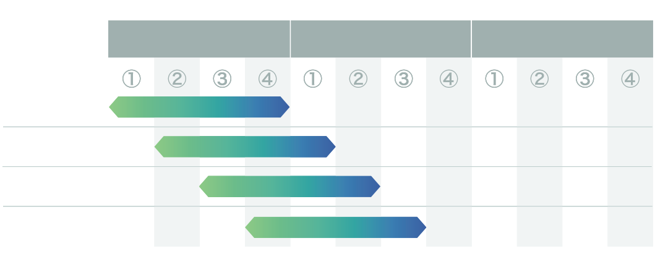
ROLLING 4 EXAMPLES
PERIOD 133
PERIOD 134
PERIOD 135
Example 01
Example 02
Example 03
Example 04

Slide 12
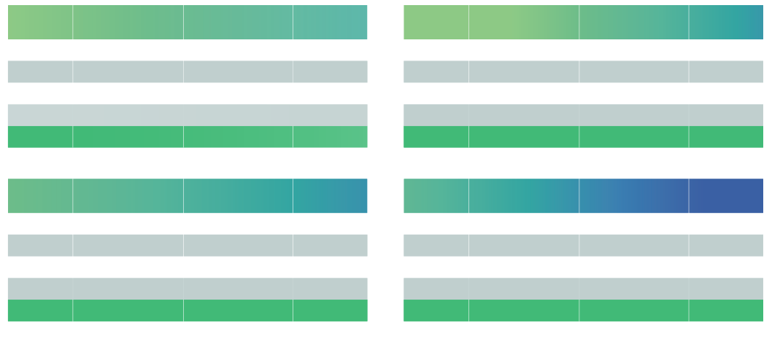
ROLLING 4 EXAMPLES
BRONZE
GOLD
PERIOD/
CYCLE
RANK VOLUME
LEFT
RANK VOLUME
RIGHT
BUILDER 500
PERIOD/
CYCLE
RANK VOLUME
LEFT
RANK VOLUME
RIGHT
BUILDER 500
133-1
500
500
0
133-1
1100
1000
1
133-2
500
500
1
133-2
500
1000
0
133-3
500
0
1
133-3
500
1200
1
133-4
0
500
0
133-4
2000
800
0
TOTAL
1500
1500
2
TOTAL
4100
4000
2
EMERALD
TRIPLE DIAMOND
PERIOD/
CYCLE
RANK VOLUME
LEFT
RANK VOLUME
RIGHT
BUILDER 500
PERIOD/
CYCLE
RANK VOLUME
LEFT
RANK VOLUME
RIGHT
BUILDER 500
133-1
7050
5400
1
133-1
37600
48200
1
133-2
10700
12700
0
133-2
29100
24500
3
133-3
5300
1200
2
133-3
32300
32100
2
133-4
3500
4800
1
133-4
24300
24800
1
TOTAL
26550
24100
4
TOTAL
123300
129600
7

Slide 13
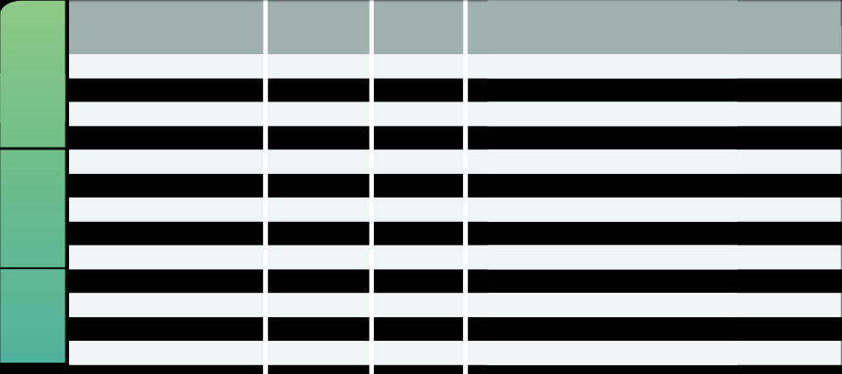
RANK QUALIFICATIONS
RANK VOLUME IN LESSER LEG
B500 QUALIFIED
LEG
RANK
SPONSOR TREE VOLUME REQUIREMENT
BUILDER
Distributor
—
—
—
Builder
75
—
—
Builder 500
500
—
—
Builder 1000
1,000
—
—
Bronze
1,500
1
—
Silver
2,500
1
—
LEADERSHIP
Gold
4,000
2
—
White Gold
12,000
2
—
Platinum
16,000
3
—
Emerald
24,000
4
—
SENIOR LEADERSHIP
Diamond
45,000
5
—
Double Diamond
80,000
5
—
Triple Diamond
120,000
5
—

Slide 14
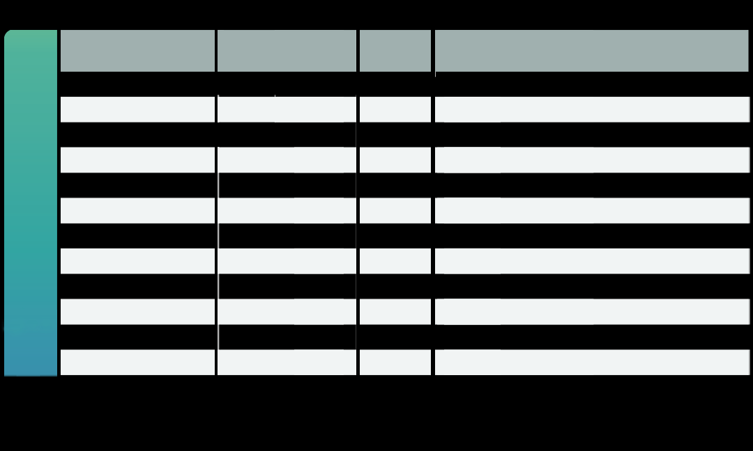
RANK QUALIFICATIONS
RANK VOLUME IN LESSER LEG
B500 QUALIFIED
LEG
RANK
SPONSOR TREE VOLUME REQUIREMENT
Black Diamond
120,000
6
200,000/No more than 50% coming from one Enrollment Leg
Double Black Diamond
120,000
6
300,000/No more than 41% coming from one Enrollment Leg
Triple Black Diamond
120,000
6
400,000/No more than 36% coming from one Enrollment Leg
Diamond Elite
120,000
6
500,000/No more than 33% coming from one Enrollment Leg
Double Diamond Elite
120,000
6
750,000/No more than 29% coming from one Enrollment Leg
SENIOR EXECUTIVE LEADERSHIP
Triple Diamond Elite
120,000
6
1,000,000/No more than 26% coming from one Enrollment Leg
Imperial Diamond
120,000
6
1,500,000/No more than 24% coming from one Enrollment Leg
Double Imperial Diamond
120,000
6
2,000,000/No more than 22% coming from one Enrollment Leg
Triple Imperial Diamond
120,000
6
2,500,000/No more than 20% coming from one Enrollment Leg
Crowne Diamond Elite
120,000
6
3,000,000/No more than 19% coming from one Enrollment Leg
Double Crowne Diamond Elite
120,000
6
4,000,000/No more than 18% coming from one Enrollment Leg
Triple Crowne Diamond Elite
120,000
6
5,000,000/No more than 17% coming from one Enrollment Leg

