Slide 1
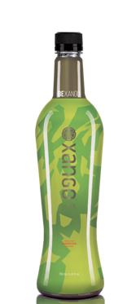
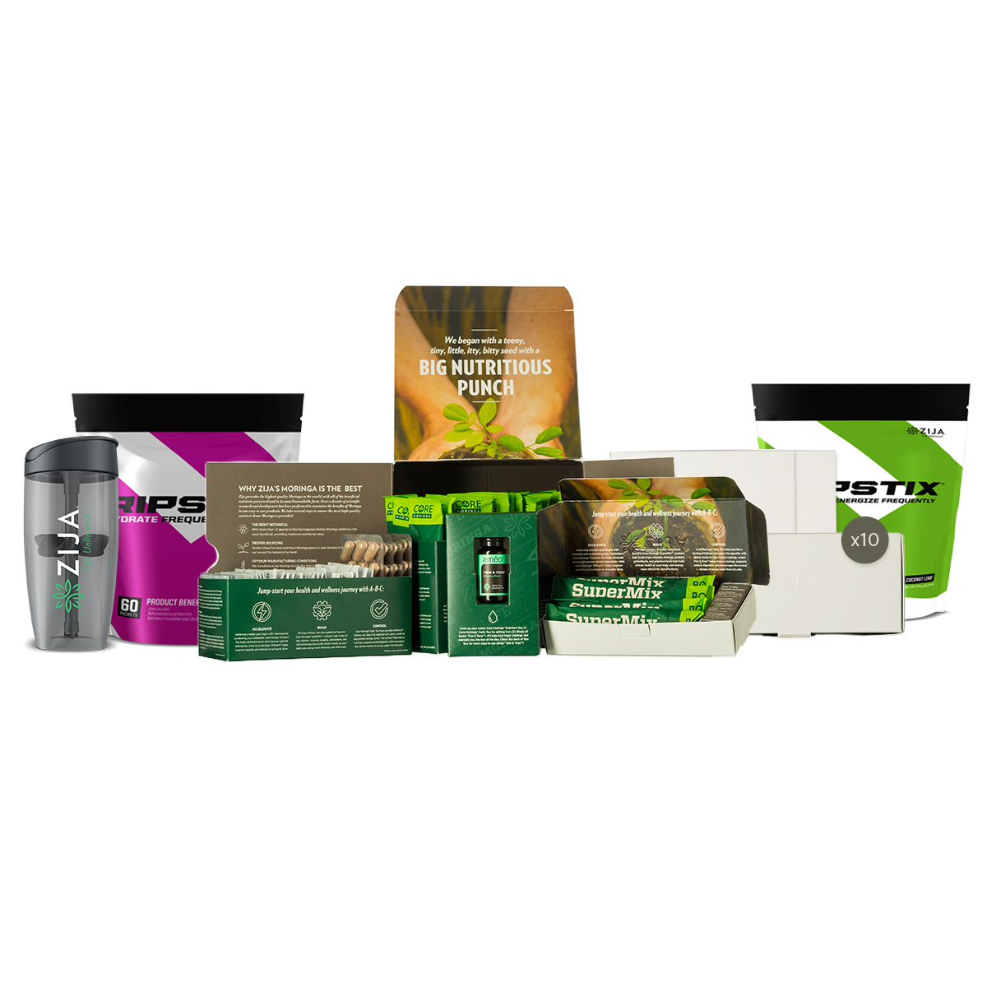
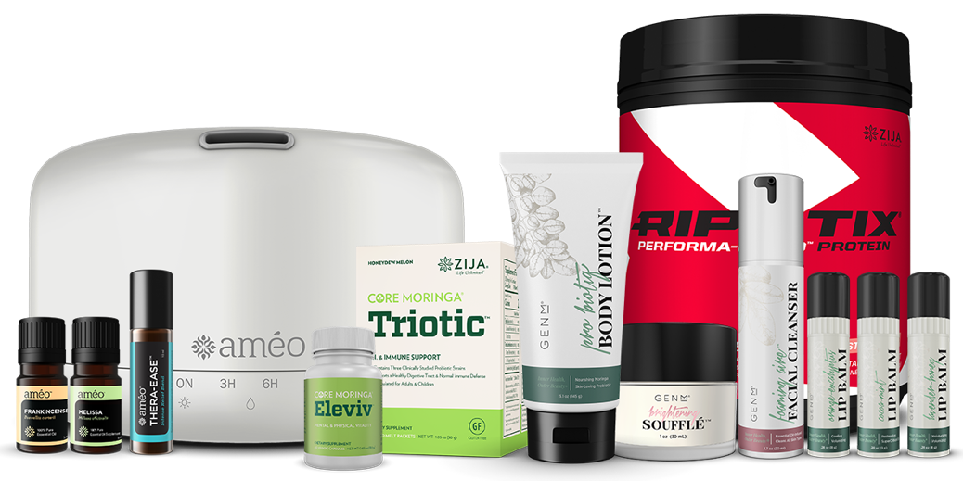
Worldwide Products and Opportunity for all Generations

Slide 2

Zija 2.0
Getting Started Training

Slide 3
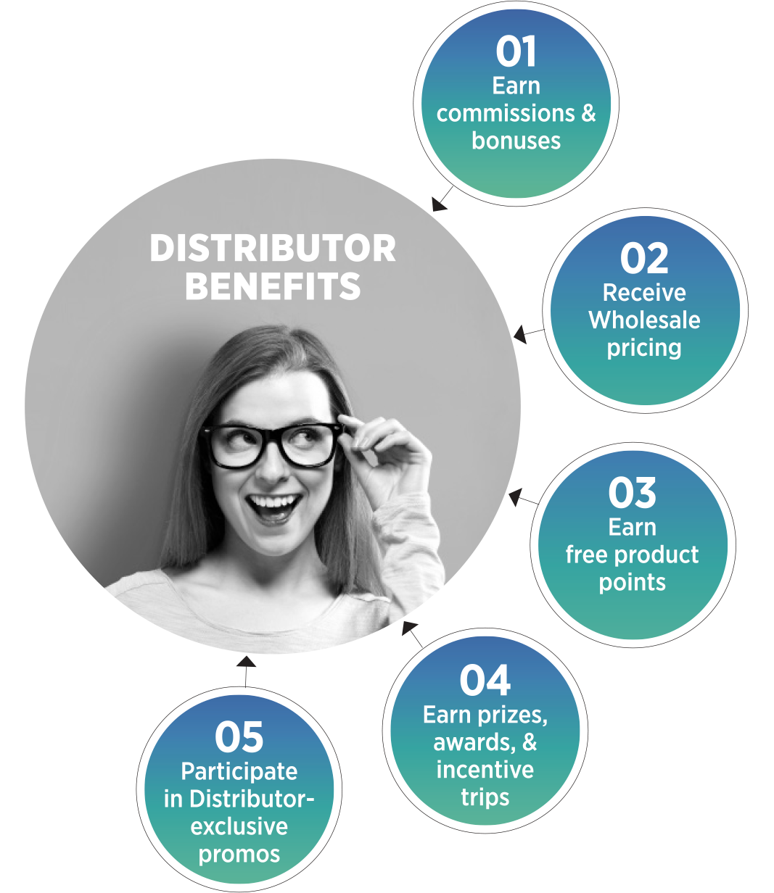
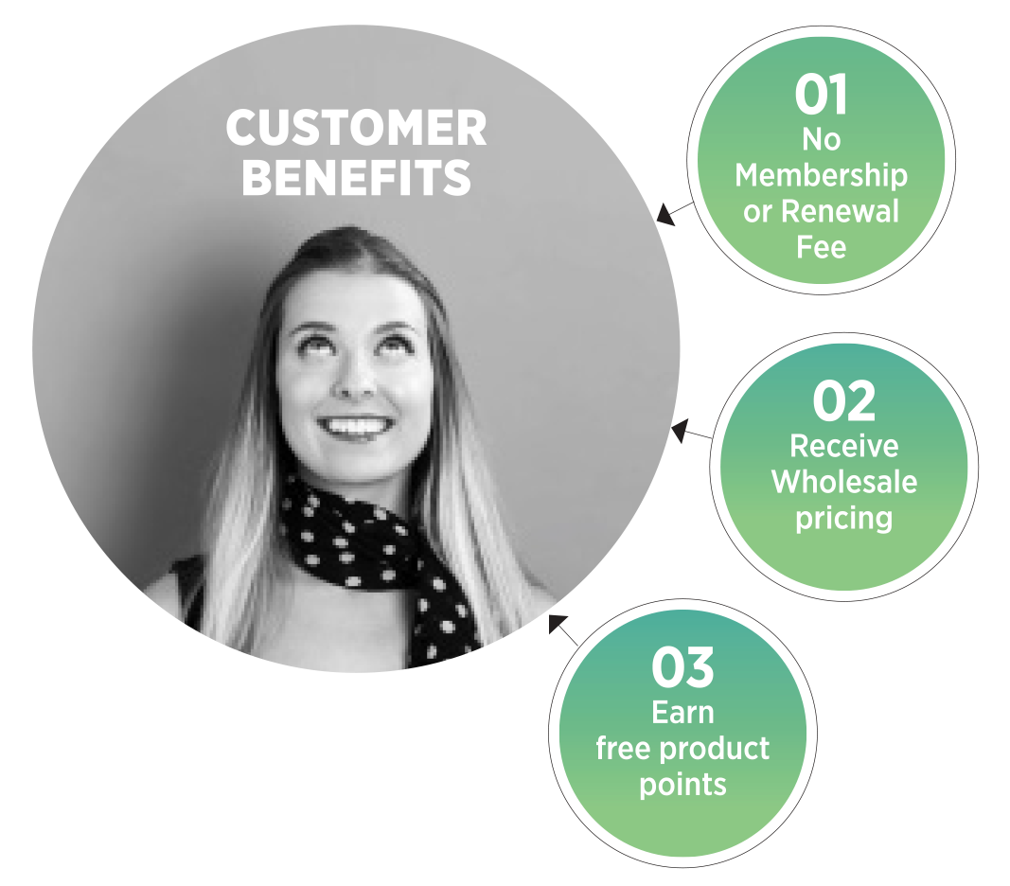
Notes:
Before you sign up as a distributor in XANGO it is important for you to review the “Before You Get Started” Training, The Compensation Plan Training, and to review the Nothing Beats FREE and Ready Set Go Programs with XANGO.
We recommend that all distributors start out as a customer. That way the clock doesn’t start for the “Ready, Set, Go< program with XANGO until you have had a chance to receive your products and try them for a few days or weeks while you are learning more about the XANGO business. We recommend that you first focus on the “Nothing Beats FREE” program with XANGO while you are still a customer. Once you have sponsored your third customer you are ready to sign up as a distributor and can take advantage of all that XANGO has to offer.
This training is designed to explain a Good, Better, and Best way to start your XANGO business for Maximum Results.

Slide 4
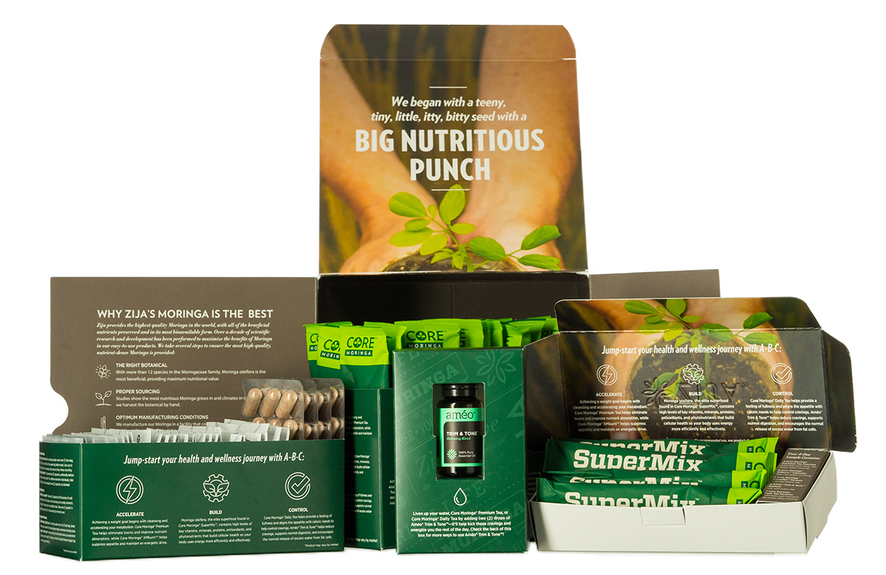
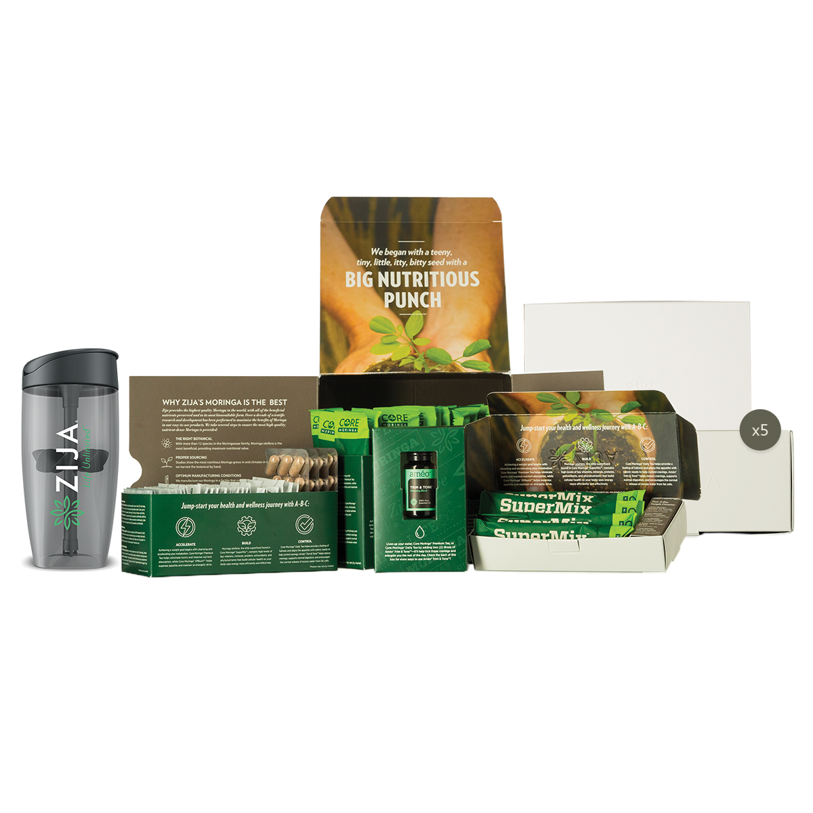
Experience the Products
Develop Your Own Story
Earn FREE Product with Customer Referrals
OR BUILDERS PLUS SYSTEM
Basic 30 for TWO at a Great Value
Double the Product + 5 FREE 4 Day Sample Packs
$330/250 PV
BASIC 30 SYSTEM
$199/150 PV

Slide 5
Ways to Start a Business in ZIJA
GOOD…
BETTER…
BEST…

Slide 6
A GOOD Way to Start a Business
Enroll as a Zija Distributor with a 150 PV ZRP
Place an Initial Order for a BUILDER PLUS SYSTEM
$330 / 250 PV
30 Day NHR Kit for TWO people PLUS 5 FREE 4 Day NHR Sample Packs.
NOTE: Your 1st ZRP won’t ship until next month unless you add to initial order.
Notes:
This will give you products to consume to develop your personal product experience story and qualify you to earn Weekly Power Start and Monthly Unilevel Bonuses.
You also have 80 Limitless Samples to share with prospective customers and business partners and do your own “Test Market” with people YOU KNOW to help evaluate the XANGO product and business opportunity. A “Test Market” is a method to use the “Opinion Approach”, a very effective way to present the products and opportunity to people that you know to help you develop your own belief in the products and opportunity while getting your business off to a Fast Start.

Slide 7
A BETTER Way to Start a Business
Enroll as a Zija Distributor with a 150 PV ZRP
Place an Initial Order for a BUILDER PRO SYSTEM
$660 / 500 PV
30 Day NHR Kit for THREE people PLUS 10 FREE 4 Day NHR Sample Packs.
NOTE: Your 1st ZRP won’t ship until next month unless you add to initial order.
Notes:
This will give you products to consume to develop your personal product experience story and qualify you to earn Weekly Power Start and Monthly Unilevel Bonuses.
You also have 80 Limitless Samples to share with prospective customers and business partners and do your own “Test Market” with people YOU KNOW to help evaluate the XANGO product and business opportunity. A “Test Market” is a method to use the “Opinion Approach”, a very effective way to present the products and opportunity to people that you know to help you develop your own belief in the products and opportunity while getting your business off to a Fast Start.

Slide 8
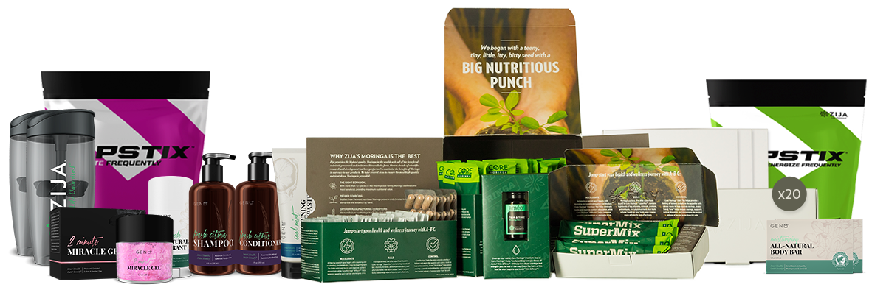
The BEST Way to Start a Business
Enroll as a Zija Distributor with a 150 PV ZRP
Place an Initial Order for a BUILDER PREMIUM SYSTEM
$1320 / 1000 PV
30 Day NHR Kit for FOUR people PLUS 20 FREE 4 Day NHR Sample Packs.
NOTE: Your 1st ZRP won’t ship until next month unless you add to initial order.
Notes:
This will give you products to consume to develop your personal product experience story and qualify you to earn Weekly Power Start and Monthly Unilevel Bonuses.
You also have 80 Limitless Samples to share with prospective customers and business partners and do your own “Test Market” with people YOU KNOW to help evaluate the XANGO product and business opportunity. A “Test Market” is a method to use the “Opinion Approach”, a very effective way to present the products and opportunity to people that you know to help you develop your own belief in the products and opportunity while getting your business off to a Fast Start.

Slide 9
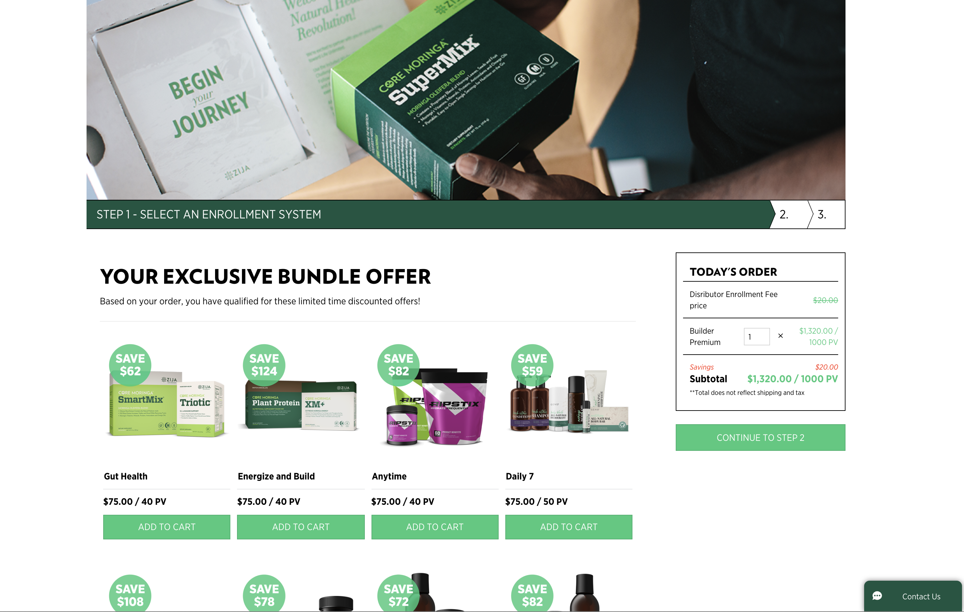
EXPLORE ZIJA
Exclusive EXPLORE ZIJA Bundles available only at enrollment. You can purchase a Basic 30 or Builder Plus Pack and them ADD ON Bundles of Products that YOU are interested in Using or Promoting in your business.
Explore Zija Bundles offer HUGE Discounts and are allow us to Build with the Zija Building Blocks and ADD Targeted Products to create a 500 PV or 1000 PV Custom System.
Notes:
This will give you products to consume to develop your personal product experience story and qualify you to earn Weekly Power Start and Monthly Unilevel Bonuses.
You also have 80 Limitless Samples to share with prospective customers and business partners and do your own “Test Market” with people YOU KNOW to help evaluate the XANGO product and business opportunity. A “Test Market” is a method to use the “Opinion Approach”, a very effective way to present the products and opportunity to people that you know to help you develop your own belief in the products and opportunity while getting your business off to a Fast Start.

Slide 10
First Things First
Become a MEMBER
  Customer First ZRP (Zija Rewards Purchase)
  Distributor ($20 enrollment fee waived with Systems)
  Good, Better, Best Enrollment Systems
Be ACTIVE
  Active 75 (75+ PV, Earn 15% Fast Start Commissions (FSC)
  Active 150 (150+ PV, Earn 25% Fast Start Commissions (FSC)
Get QUALIFIED
  Sponsor 2 Active Distributors (75 or 150)
  Place one in Left Team and Place one in Right Team
Congratulations! You are now Active and Qualified to Earn Commissions
Commit to a ZRP each month and earn Zija Rewards Points which can be redeemed for FREE product.
CYCLE – A calendar week that begins and ends each Friday night at midnight. There are 7 days in a cycle.
ROLLING PERIOD – Four Consecutive Cycles.
ACTIVE – Have a personal order of 75 PV or higher during a rolling 4 cycle period.
ACTIVE 75 – Have a personal order of 75 PV or higher during a rolling 4 cycle period.
ACTIVE 150 – Have a personal order of 150 PV or higher during a rolling 4 cycle period.
QUALIFIED – Have Two Active Personally-Sponsored Members, One on your Left Team, One on your Right Team.

Slide 11
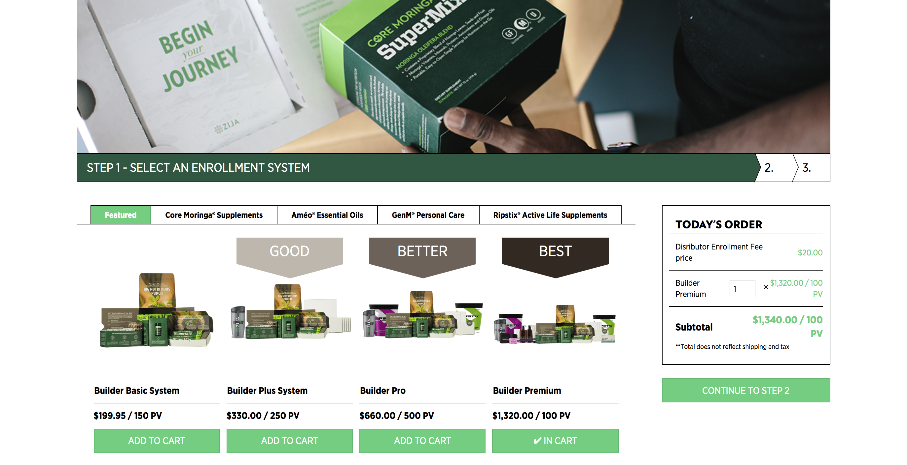
ZIJA 2.0: ENROLLMENT
Distributor Enrollment – Step 1
Pick an Enrollment System
1000 PV
Notes:
Best

Slide 12
ZIJA 2.0: ENROLLMENT
Distributor Enrollment – Step 2
Notes:
Best

Slide 13
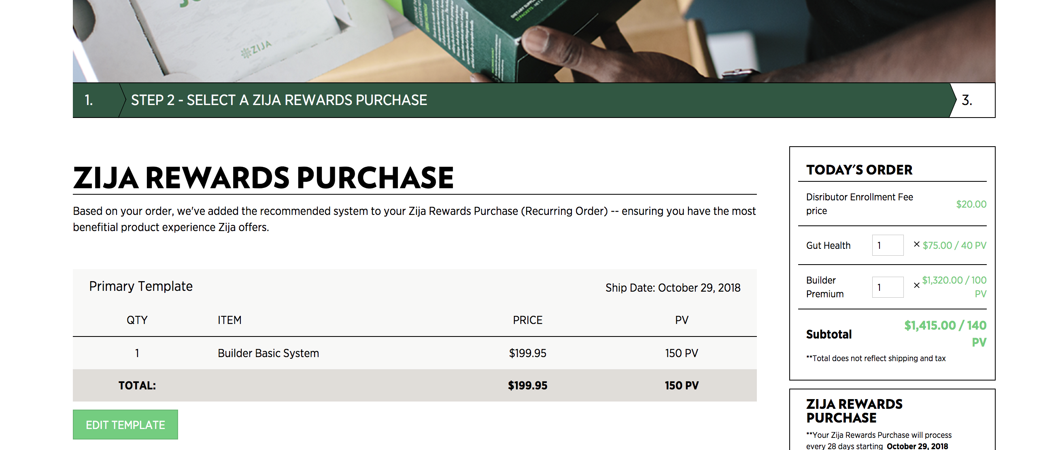
ZIJA 2.0: ENROLLMENT
Distributor Enrollment – Step 3
Confirm Zija Rewards Purchase
Notes:
Best

Slide 14
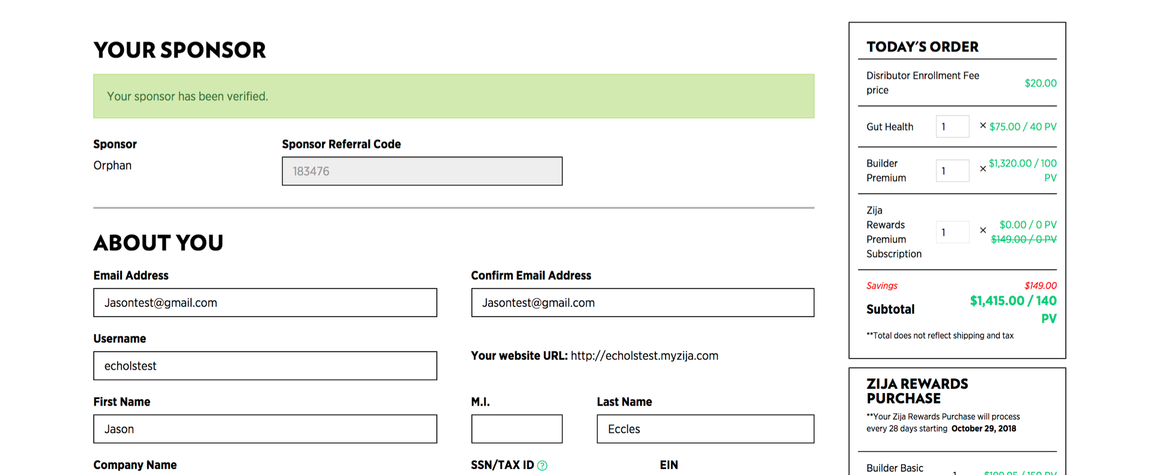
ZIJA 2.0: ENROLLMENT
Distributor Enrollment – Step 4
Notes:
Best

Slide 15
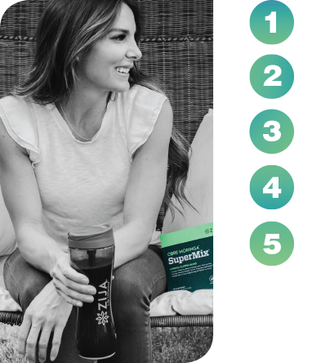
5 WAYS TO EARN
Fast Start Commissions (FSC)
Get Qualified Bonus (GQ Bonus)
Team Commissions
Customer Retention Bonuses
Leadership Bonuses

Slide 16
SPONSOR TREE
Each Distributor you sponsor and those they sponsor through infinite levels
YOU
Active 75/150
PERSONALLY SPONSORED
Personally Sponsored
Personally Sponsored
Personally Sponsored
Personally Sponsored
Personally Sponsored
Personally Sponsored
All of your personally enrolled distributors make a new sponsor tree leg.
Fast Start Commissions are paid for the initial order of your Personally Sponsored Distributors.
A Builder 500 leg is a sponsor tree leg where someone in the leg reaches the rank of Builder 500 or above.
Starting at the rank of Bronze qualifications are determined by how many Builder 500 legs you have.
Starting at the rank of Black Diamond qualifications are determined by how much volume you have in your sponsor tree.
BINARY TREE
Placement of all Customers and Distributors regardless of Sponsor
Your binary tree is based on placement. You have two placement legs. Your Left team and your Right team. Some of these distributors may have been sponsored by distributors in your Upline. This is called Spillover.
Starting at the rank of Builder 500 and above qualifications are determined by how much volume is on each team.
Team Commissions are paid based on your Binary team volume.

Slide 17
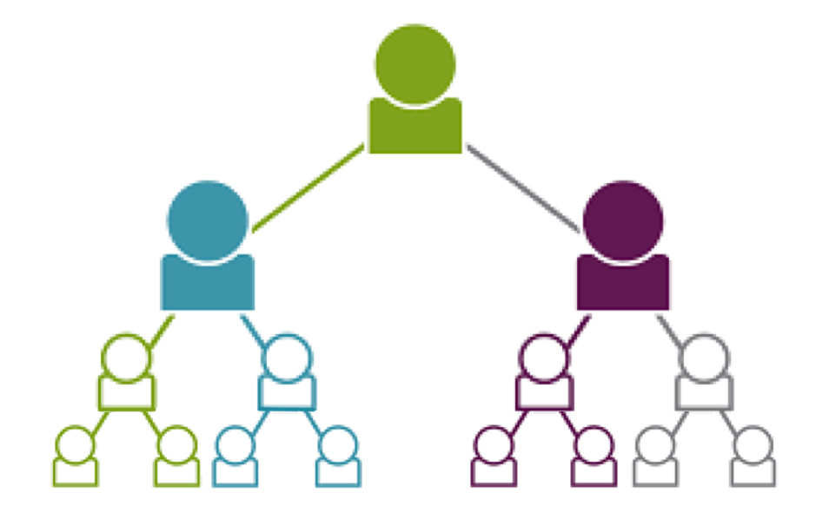
GROW Your TEAM… GROW Your VOLUME… GROW Your Rank
$
$
$$$
$$$
GET ACTIVE & QUALIFIED
$$
$$
DUPLICATE TO INFINITY
The More People You Help
The More Volume You Have
The Faster You Rank Up
HELP YOUR PEOPLE QUALIFY

Slide 18
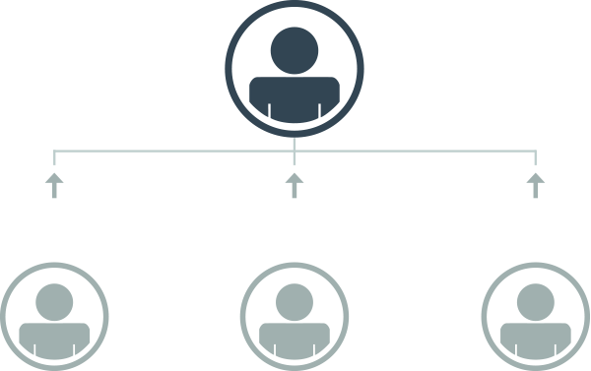


FAST START COMMISSIONS
ACTIVE 75
YOU EARN
ACTIVE 150
YOU EARN
YOU
(FSC)
(FSC)
25% = $37.50
15% = $22.50
25% = $62.50
15% = $37.50
25% = $125
15% = $75
150 PV
250 PV
500 PV
Initial Order from
Newly Enrolled
Customer
Initial Order from
Newly Enrolled
Customer
Initial Order from
Newly Enrolled
Distributor

Slide 19
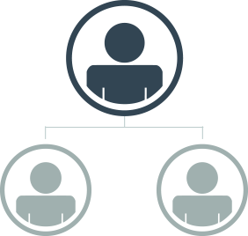


GET QUALIFIED BONUS
OR
YOU
YOU
ENROLL
1
ENROLL
2
ENROLL
1
ENROLL
2
150 PV
Initial Order
&
75+ PV
Zija Rewards
Purchase
150 PV
Initial Order
&
75+ PV
Zija Rewards
Purchase
250 PV
Initial Order
&
75+ PV
Zija Rewards
Purchase
250 PV
Initial Order
&
75+ PV
Zija Rewards
Purchase
*Up to $500 per Cycle
Paid on every Pair of New Customers & Distributors Enrolled in a Cycle

Slide 20
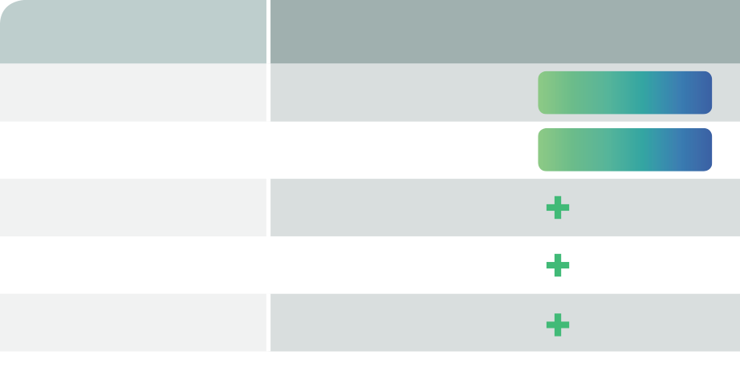
CUSTOMER RETENTION BONUSES
CUSTOMER VOLUME
LEVEL
REWARD
500 - 999
$100/75 PV
ZIJA REWARDS PURCHASE
CLUB 500
$200/150 PV
ZIJA REWARDS PURCHASE
CLUB 1000
1,000 – 2,499
$200/150 PV
ZIJA REWARDS PURCHASE
$250
CASH BONUS
2,500 – 4,999
$200/150 PV
ZIJA REWARDS PURCHASE
$500
CASH BONUS
5,000 – 9,999
$200/150 PV
ZIJA REWARDS PURCHASE
$1,000
CASH BONUS
10,000

Slide 21
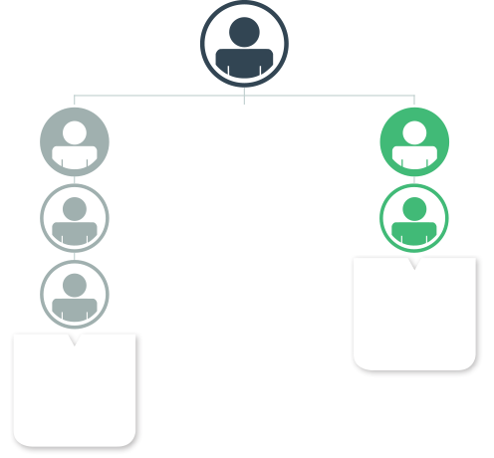
TEAM COMMISSIONS
YOU EARN
PLUS
You also Earned…
$500 Fast Start Commissions
(on your 2 personally enrolled)
$100 GQ Bonus
(on your 2 personally enrolled if within one cycle)
TOTAL
$750
$150
YOU
In Team Commissions
LEFT LEG
RIGHT LEG
1000 PV
PE
1000 PV
PE
500 PV
500 PV
TOTAL
1500
COMMISSIONABLE
VOLUME
250 PV
TOTAL
1750
COMMISSIONABLE
VOLUME

Slide 22
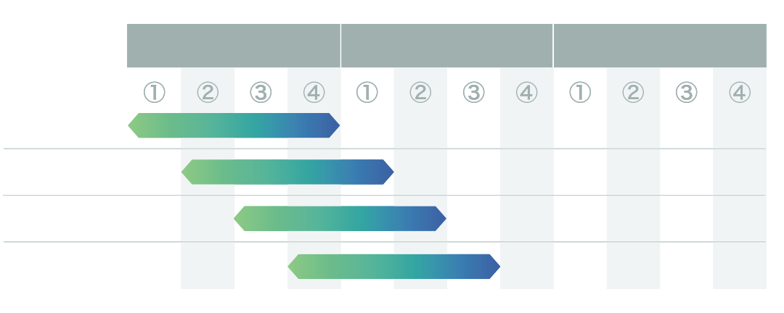
ROLLING 4 WEEK QUALIFICATIONS
PERIOD 133
PERIOD 134
PERIOD 135
Example 01
Example 02
Example 03
Example 04
Every week your rank is based on all of the volume you did THAT WEEK + THE PREVIOUS 3 WEEKS
This is like a monthly qualification plan with weekly pay EVERY SINGLE WEEK!

Slide 23





Building Your Business One RANK at a Time!
BUILDER 500
BRONZE
GOLD
Be Active (75 PV) & Qualified
500+ Rank GV on Each Team in a rolling 4 week period.
Earning Potential $500 week
Be Active (75 PV) & Qualified
1,500 Rank GV on each Team in a rolling 4 week period.
Develop 1 Builder 500 Leg
Earning Potential $750 TC week +
Be Active (75 PV) & Qualified
4,000 Rank GV on each team in a rolling 4 week period.
Develop 2 Builder 500 Legs
Earning Potential $1500 TC week +
EMERALD
DIAMOND
Be Active (75 PV) & Qualified
24,000 Rank GV on each team in a rolling 4 week period
Develop 4 Builder 500 Legs
Earning Potential $3,000 TC week +
Be Active (150 PV) & Qualified
45,000 Rank GV on each team in a rolling 4 week period.
Develop 5 Builder 500 Legs
Earning Potential $5,000 TC week +

Slide 24
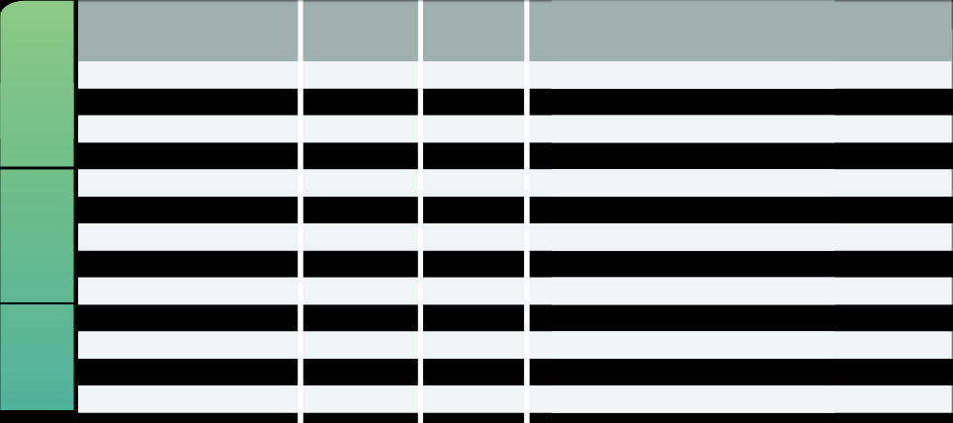
RANK QUALIFICATIONS
RANK VOLUME IN
LESSER LEG
B500 QUALIFIED
LEG
RANK
SPONSOR TREE VOLUME REQUIREMENT
BUILDER
Distributor
—
—
—
Builder
75
—
—
Builder 500
500
—
—
Builder 1000
1,000
—
—
Bronze
1,500
1
—
Silver
2,500
1
—
LEADERSHIP
Gold
4,000
2
—
White Gold
12,000
2
—
Platinum
16,000
3
—
Emerald
24,000
4
—
Diamond
45,000
5
—
SENIOR LEADERSHIP
Double Diamond
80,000
5
—
Triple Diamond
120,000
5
—

Slide 25
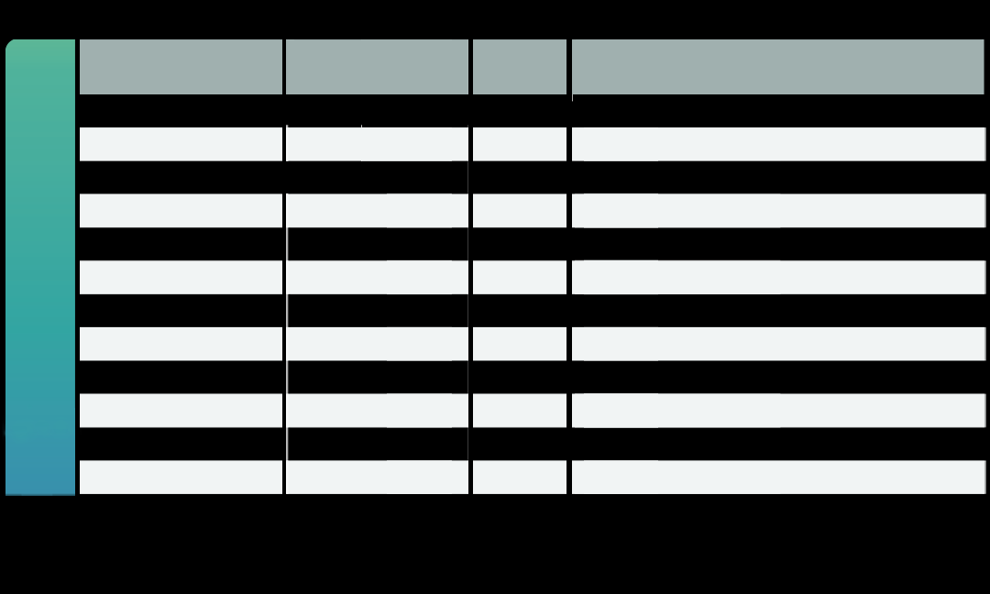
RANK QUALIFICATIONS
RANK VOLUME IN
LESSER LEG
B500 QUALIFIED
LEG
RANK
SPONSOR TREE VOLUME REQUIREMENT
Black Diamond
120,000
6
200,000/No more than 50% coming from one Enrollment Leg
Double Black Diamond
120,000
6
300,000/No more than 45% coming from one Enrollment Leg
Triple Black Diamond
120,000
6
400,000/No more than 40% coming from one Enrollment Leg
Diamond Elite
120,000
6
500,000/No more than 35% coming from one Enrollment Leg
Double Diamond Elite
120,000
6
750,000/No more than 30% coming from one Enrollment Leg
SENIOR EXECUTIVE LEADERSHIP
Triple Diamond Elite
120,000
6
1,000,000/No more than 25% coming from one Enrollment Leg
Imperial Diamond
120,000
6
1,500,000/No more than 25% coming from one Enrollment Leg
Double Imperial Diamond
120,000
6
2,000,000/No more than 20% coming from one Enrollment Leg
Triple Imperial Diamond
120,000
6
2,500,000/No more than 20% coming from one Enrollment Leg
Crowne Diamond Elite
120,000
6
3,000,000/No more than 18% coming from one Enrollment Leg
Double Crowne Diamond Elite
120,000
6
4,000,000/No more than 18% coming from one Enrollment Leg
Triple Crowne Diamond Elite
120,000
6
5,000,000/No more than 18% coming from one Enrollment Leg

Slide 26
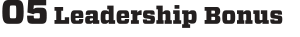
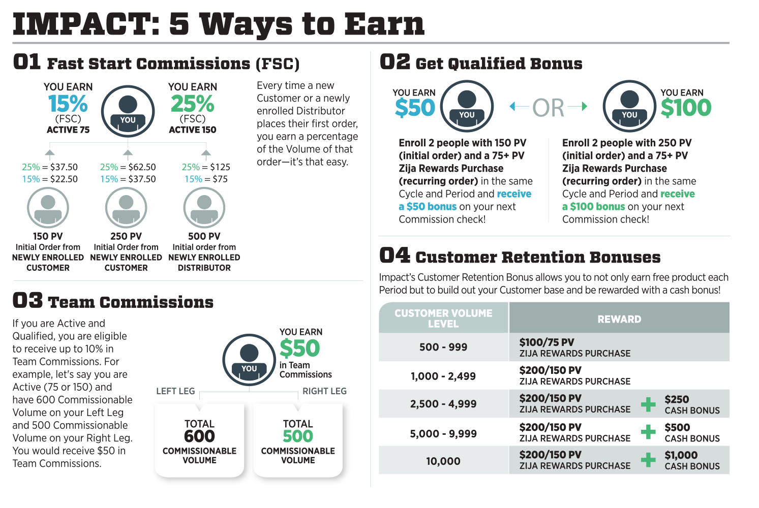
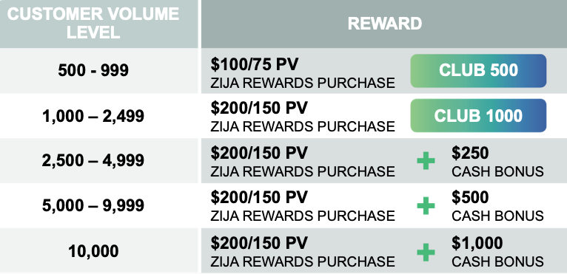
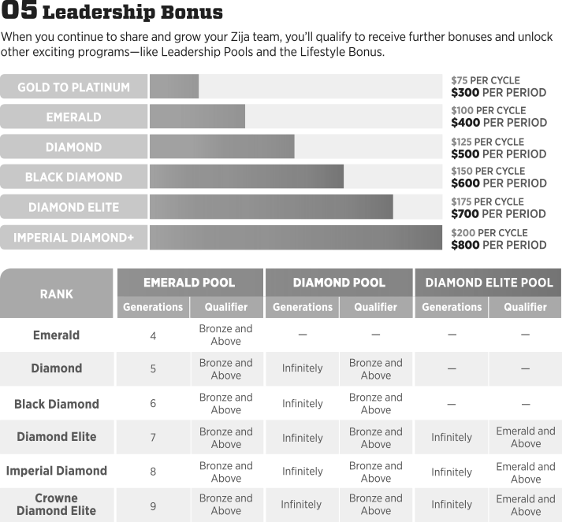

Slide 27




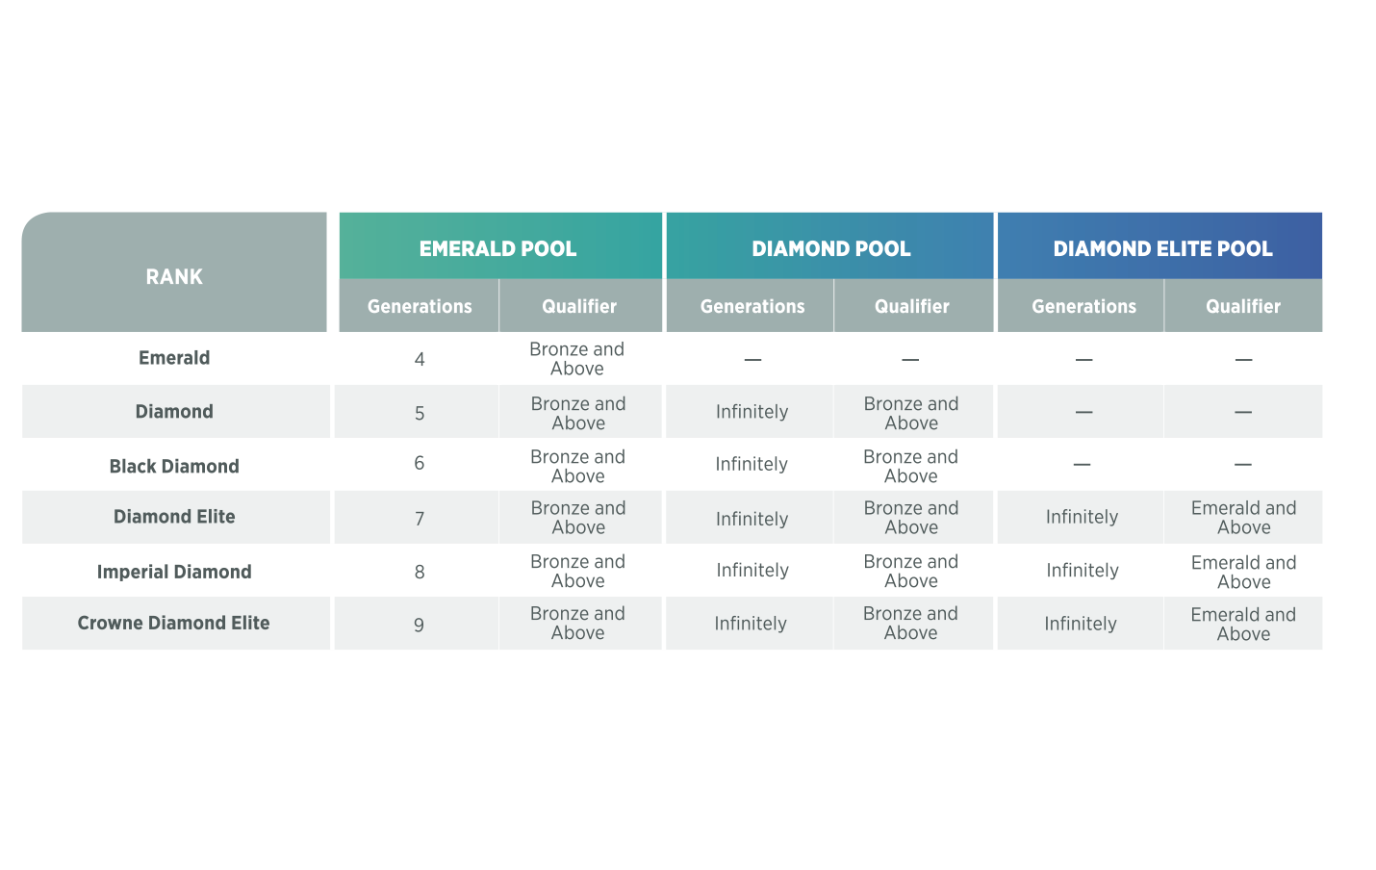
LEADERSHIP BONUSES
Qualified Rank w/ $15,000 Sponsor Tree Volume

Slide 28
ZIJA PROFIT PARTICIPATION PLAN (PPP)
Zija Founder Ken Brailsford shares Zija profits with leaders.
25% of NET PROFITS shared with leaders in 5 Separate Pools.
Pool 1 opened in Spring 2011 to DIAMONDS.
Pool 2 expected to open in Spring 2020 to BLACK DIAMONDS.
This is IN ADDITION to the Full 50% paid out in the Zija Compensation Plan!

Slide 29
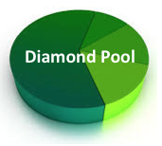

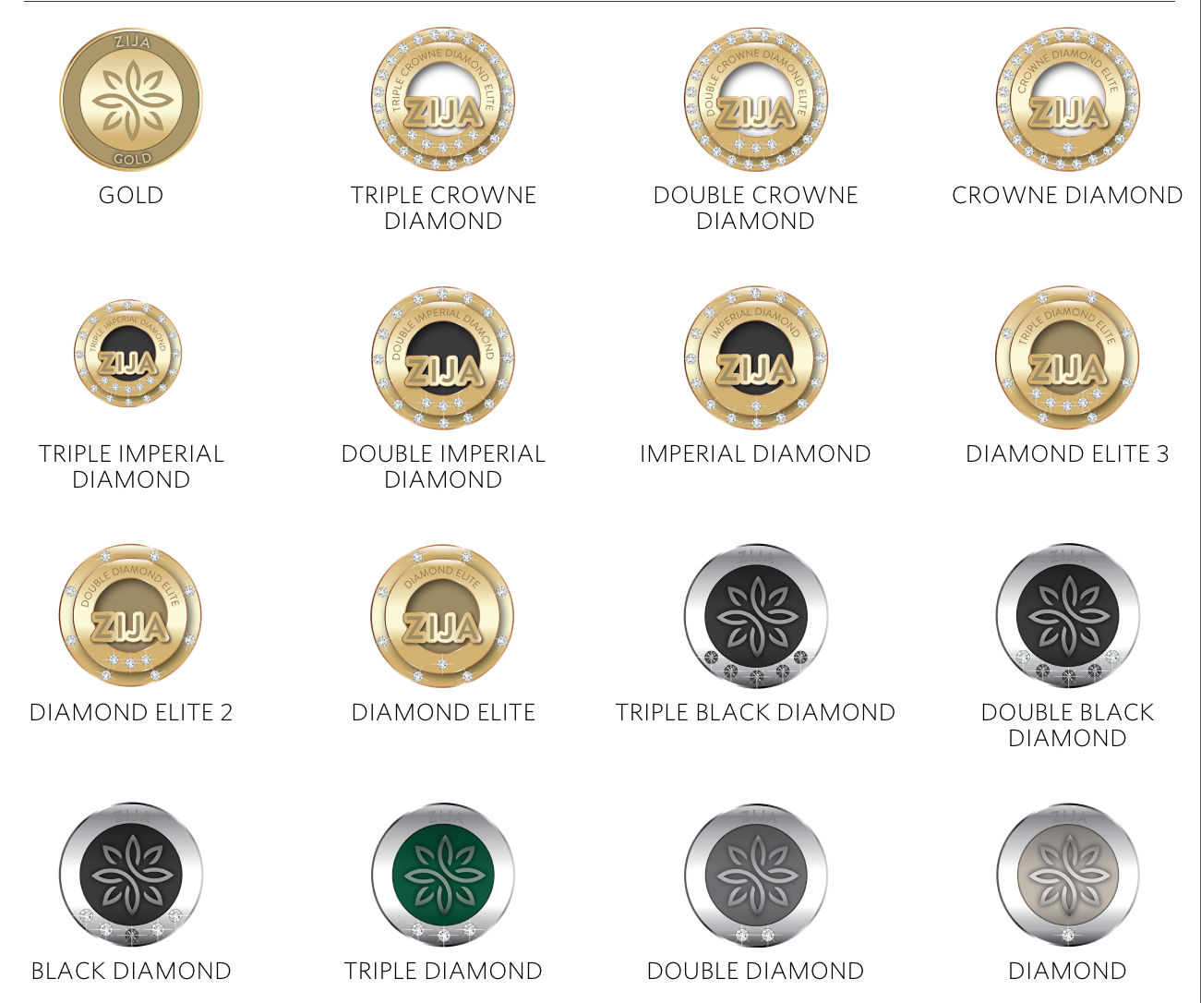
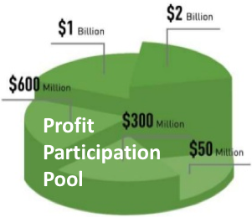
GO DIAMOND!
LIVE LIFE UNLIMITED!

Slide 30



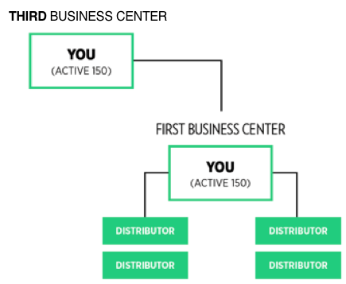
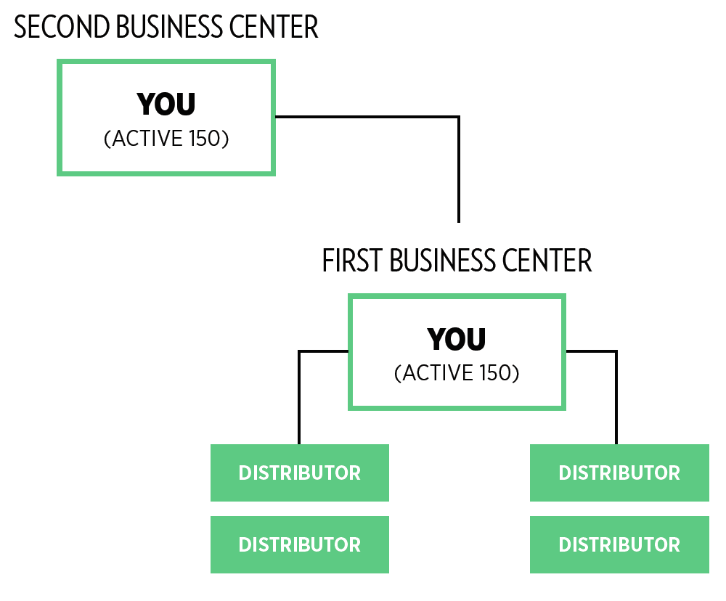
GO BLACK DIAMOND!
LIVE THE LIFE
OF YOUR DREAMS
Earn a Share in PPP 1
Earn a Share in PPP 2

Slide 31

Are YOU IN?
Let’s DO THIS DEAL!

Slide 32
Join us on the Next Zija Incentive Trip!
Playa del Carmen Mexico June 18th – 23rd

